Slide 1

Enzymatic Processes in Industrial Production & its application
By Hardik Tyagi
From Division D
Roll no: D-52

Slide 2
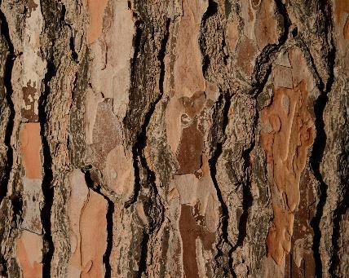
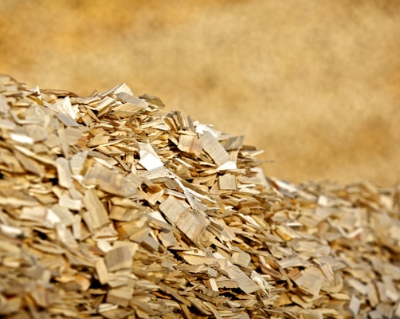
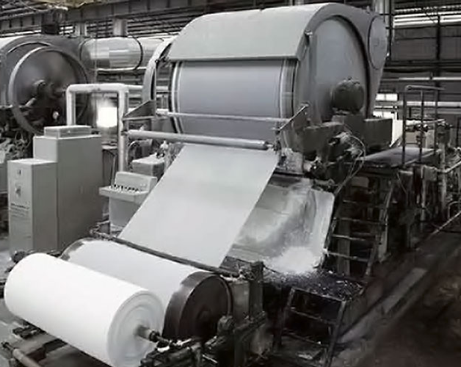
Agenda
The Role of Xylanase in Paper and Pulp Industry
Process Description (Kraft Pulp Bleaching)
Process Conditions For Kraft Pulp Bleaching
Details on The Product Made Using Xylanase
Industrial Applications Of Xylanase
My Role As Engineer in The Industry

Slide 3
The Role of Xylanase in Paper and Pulp Industry
Xylanase is an enzyme that breaks down xylan, a hemicellulose found in plant cell walls.
In the paper and pulp industry, it is primarily used in the pre-bleaching process of kraft pulp to reduce the need for harsh chemical bleaching agents like chlorine.
Due to the Bleaching Process, the brightness of the pulp increases and it reduces the cost of bleaching by nearly 89%.

Slide 4
Process Description (Kraft Pulp Bleaching)
Due to kraft pulping, short Xylan chains deposit onto fiber surfaces. Xylan physically traps the lignin, which results in fiber swelling. These Xylans act as a barrier and prevent the penetration of bleaching agents. This leads to increased use of chlorine dioxide (ClO2) during the first bleaching stage.
Xylanase enzymes break the link between lignin and hemi-cellulose and thus remove Xylan. During the next stage of the bleaching process, lignin is removed easily as its links with hemi-cellulose have been broken down. Reduction in Xylan concentration increases the fiber permeability, thus improving its bleachability.

Slide 5
Process Conditions For Kraft Pulp Bleaching
The bio bleaching parameters optimization showed that 30 U/g of xylanases, at pH 5, at 50 °C, during 30 min, are the best conditions to bleach the crude Kraft pulp (3% of consistency).
l A decrease of 12.5% of Kappa number, as well as the release of 1 g/lL of sugar, and the presence of chromophores compounds (237 nm) are also observed.
These Conditions are subjected to changes according to the industry and Materials used by the Industry, so these can be changed according to the requirements and quality of paper required by the Industry.

Slide 6
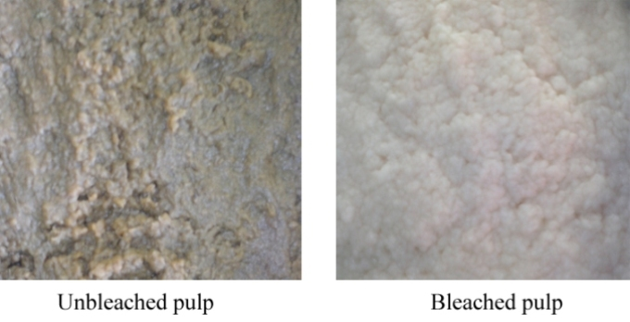
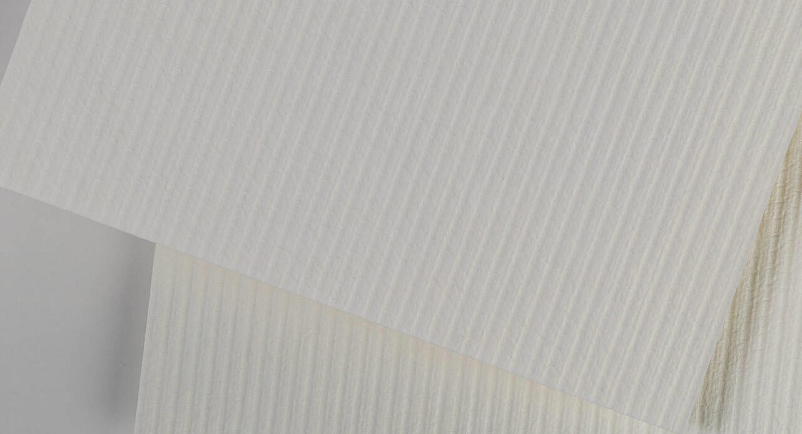
Details on The Product Made Using Xylanase
The Bleached Kraft pulp is the product formed after Bleaching with Xylanase.
Depending on the Material used it can be Wood or Kraft pulp.
After Bleaching of Kraft Pulp, it is then use to make Bright Yellow or White Papers or Paper Related Items.

Slide 7
Industrial Applications Of Xylanase
Xylanase is used in the pre-bleaching stage to break down Xylan, making it easier to remove lignin.
This reduces the need for harsh chemicals like chlorine and other chemicals.
This also allows to reduce water pollution and other types of pollution.
Xylanase also reduces the cost for process and increases the quality of paper by increasing the brightness after bleaching.

Slide 8
My Role As Engineer in The Industry
Since this Industry Relies on the different types of materials and resources, I would then automate the process which are best for that respective material, which are also under same or different types of conditions.
By automating the processes, we will have higher quality of paper and the brightness of the pulp after bleaching will be increased.
Also, by automating the different process we can promote research in this field which will bring more development towards society.
Also, by automating the process we can encourage environment friendly processes which will allow us to reduce different types of Pollutions.

Slide 9
Reference
Photos
Details
What is Wood Pulp and paper & How is it made | naturally:wood
Pulp and Paper Manufacturing Process Overview
What is bleaching of pulp - pulp paper mill
Metsä Birch bleached hardwood kraft pulp | Metsä Fibre
Xylanase – Wikipedia
Application Of Xylanase Enzyme In Pulp & Paper Industry | Infinita Biotech
Biobleaching application of cellulase poor and alkali stable xylanase from Bacillus pumilus SV-85S – PMC
Biobleaching of Kraft pulp using fungal xylanases produced from sugarcane straw and the subsequent decrease of chlorine consumption - ScienceDirect
Template - Microsoft Create

Slide 10

Thank you
By Hardik Tyagi
From Division D
Roll no: D-52
Email Id: hardik.tyagi@somaiya.edu

